Slide 1
L4/5 Group 12
GROUP PROJECT
River Chick, Quwaine Dantes-Mcpherson,
Sam Ormondroyd and Charlie Kinglake

Slide 2
Obscure Sorrows
Onism – The frsutration of being stuck in one body that inhabits just one place at a time.
Liberosis – The desire to care less about things.

Slide 3
Onism
In our game you control one character per move and after you have finished that move the enemies all move into their next position.
Our aim here is to frustrate the player as they only have a limited number of turns and it turns what could be easy if you could move all of them at once into a moderately difficult game as you have to think ahead about your moves and the enemies moves.

Slide 4
Liberosis
Your characters in our game are young fish that you are trying to guide past sharks to safety but in some levels you will have to sacrifice one or maybe two of your characters to reach the goal.
We are aiming for our player to care about the characters, and want to save them and become upset when they lose one to a shark.

Slide 5
Taget Audience
The target audience for our game will be middle aged females.
The game will include:
Caring for the characters.
Nurturing them and getting them home safely.

Slide 6
Average Playing Time
Our game will have short periods of playtime that will probably last around 10-20 minutes. The main aim is for it to be played when people have a spare few minutes if for example they have a lunch break or they are travelling on the train to work.

Slide 7
The Player
What the player has to do in this game is look at their moves available, the placements of the sharks and how many spots they move during one turn and work out the the optimum route to take and when to stay where they are.
The goal for them is to get as many of the fish to the end of each level as they can.

Slide 8
The Game
In this game you are playing as 3 young fish who have been seperated from your parents and your path back has been blocked by sharks.
You have to find a way to get past the sharks and reach your family before the time runs out and the sharks find you.

Slide 9
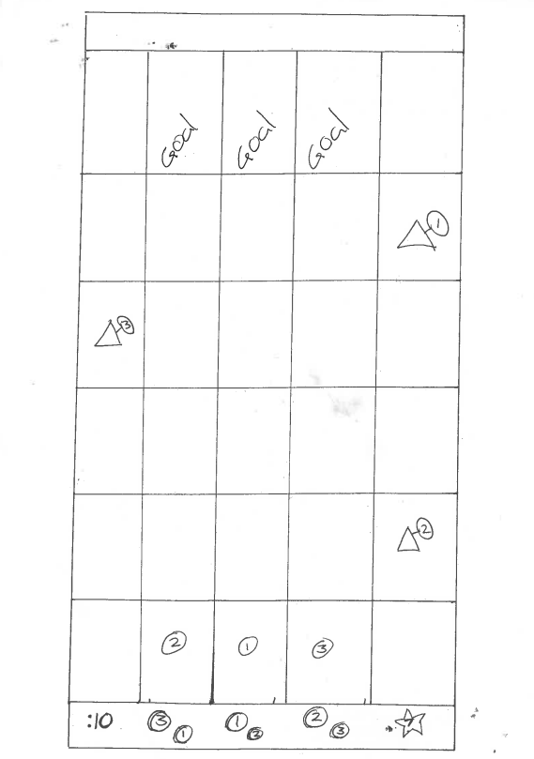
Basic Level Layout
The goal at the top of the level is where the player has to get the fish to.
The triangles are the enemies and the sign they are holding indicate the amount of squares that they move each turn.
Our characters will move in random orders and you will have certain animations to indicate which one will move first, the numbers on the circles represent the order of movement on this level.
The :10 in the bottom is the timer for each move.
Numbered coins at the bottom indicate the players move for that character and the smaller is the move for next turn.
The 7 in a star is the amount of turns the player has left before losing.

Slide 10
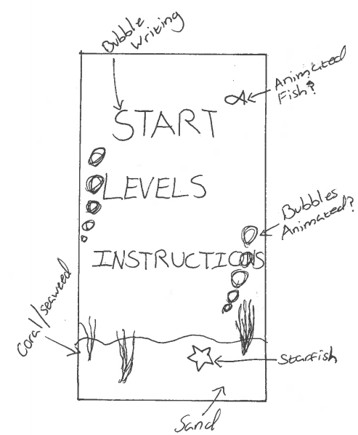
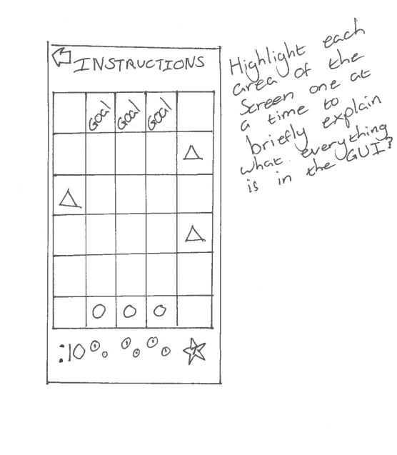
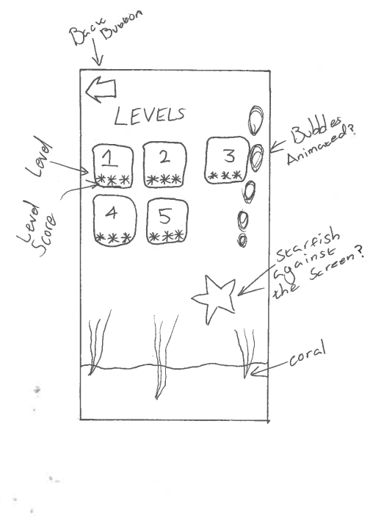
Concept Art

Slide 11
Questions?

